Slide 1
Water And Waste Water Management
Content
Introduction
Sources of water
Problems due to overuse of water
Waste water treatment
Presented by:
Dhanshree Chaudhari.

Slide 2
INTRODUCTION
Water is a vital natural resource which forms the basis of all life.
It is key resource of all economic activity.
About 97% of earth’s surface is covered by water and most of the animals and plants have 60-65% water in their body.
The water we use keeps on cycle endlessly called Hydrological cycle.

Slide 3
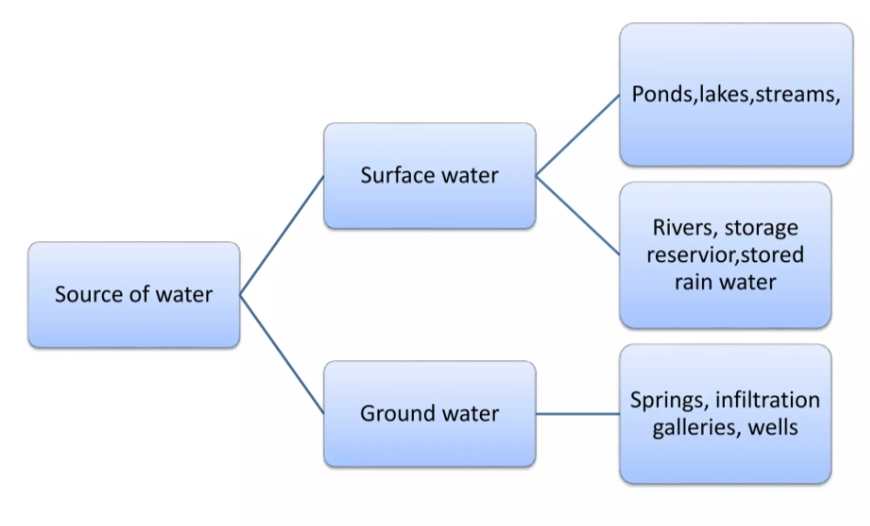
Sources Of Water

Slide 4
Problems Due To Overuse Of Water
1. Problems related with overuse of surface water.
Decrease in flow of water in stream and river.
Wetland surface reduction.
Water logging.
Migration of people.
2. Problems related with overuse of ground water.
A heavily pumped well can lower water level and wells go dry.
Heavy pumping well can delete a whole aquifer.
Overuse of freshwater reservoir along coastlines often allows saltwater to intrude into aquifers and increases the salinity of water.

Slide 5
Waste Water Treatment
Wastewater treatment is a process to convert wastewater into an effluent that
can be either returned to the water cycle. The latter is called water reclamation.
Treatment means removing impurities from water being treated.
The physical infrastructure used for wastewater treatment plant (WWTP).
PROCESSES USED:
Phase separation
Sedimentation
Filtration
Oxidation

Slide 6
Industrial Wastewater Treatment Plants
1. Agricultural wastewater treatment plants:
Agricultural wastewater treatment for continuous confined animal operations like milk and egg production may be performed in plants using mechanized treatment units similar to those described under industrial wastewater, but where land is available for ponds, setting basins and facultative lagoons may have lower operational costs for seasonal use conditions from breeding or harvest cycles.
2. Leachate treatment plants:
Leachate treatment plants are used to treat leachate from landfills. Treatment, options include biological treatment, mechanical treatment by ultrafiltration and treatment with active carbon filters.

Slide 7
Importance Of Waste Water Treatment
Due to decrease in level of drinking or usable water so it is must.
We have to reuse the waste water to meet with the requirement of water.
Water for development of industry, agriculture is must.
“Proper management is must”

Slide 8
THANK YOU.

